Slide 1
Introduction
Welcome to the presentation on Neural Style Transfer.
This presentation will provide an overview of what Neural Style Transfer is and how it works.

Slide 2
What is Neural Style Transfer?
Neural Style Transfer is a technique used in computer vision and deep learning to transfer the style of one image to another image while preserving its content.
In other words, Neural Style Transfer allows you to take the style of a famous painting, for example, and apply it to your own photograph, creating a unique artistic image

Slide 3
How does Neural Style Transfer work?
Neural Style Transfer works by using a deep neural network to extract the content and style information from two different images.
The content information is extracted from the content image, while the style information is extracted from the style image.
Then, the content and style information are combined to create a new image that has the same content as the content image but with the style of the style image.

Slide 4
What is a Neural Network?
A Neural Network is a type of machine learning algorithm that is inspired by the structure and function of the human brain.
It consists of layers of interconnected nodes that learn to recognize patterns in data and make predictions based on those patterns

Slide 5
What is a Convolutional Neural Network (CNN)?
A Convolutional Neural Network (CNN) is a type of neural network that is commonly used in computer vision tasks such as image recognition and classification.
It works by applying a series of convolutional filters to the input image to extract features and identify patterns in the data

Slide 6
How Neural Style Transfer implemented using CNN?
Neural Style Transfer is implemented using a CNN that has been pre-trained on a large dataset of images, such as ImageNet.
The pre-trained CNN is used to extract the content and style information from the content and style images, respectively.
Then, the content and style information are combined using a loss function that minimizes the difference between the content and style features in the generated image and the content and style features in the original images.

Slide 7
Loss Functions
A loss function is a mathematical function that measures the difference between the predicted output and the actual output.
In Neural Style Transfer, the loss function is used to minimize the difference between the content and style features in the generated image and the content and style features in the original images.
The loss function used in Neural Style Transfer consists of three components: content loss, style loss, and total variation loss

Slide 8
Content Loss
Content loss measures the difference between the content features in the generated image and the content features in the content image.
It is calculated as the mean squared error between the feature maps of the generated image and the content image

Slide 9
Style Loss
Style loss measures the difference between the style features in the generated image and the style features in the style image.
It is calculated as the mean squared error between the Gram matrices of the feature maps of the generated image and the style image.

Slide 10
Total Variation Loss
Total variation loss is used to reduce the high-frequency noise in the generated image.
It is calculated as the sum of the absolute differences between the neighboring pixels in the generated image.

Slide 11
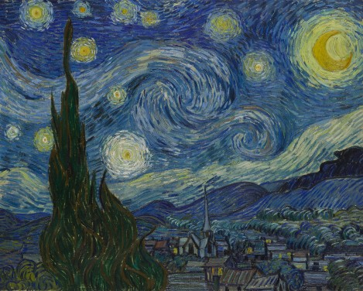
Examples of Neural Style Transfer
Van Gogh's Starry Night Style:
This example of Neural Style Transfer applies the iconic swirling style of Vincent van Gogh's "Starry Night" painting to a photograph of a cityscape. The algorithm analyzes the content of the photograph and extracts its features, such as buildings, streets, and sky, while also capturing the color and texture of Van Gogh's painting. The result is a unique and artistic image that combines the content of the original photograph with the recognizable style of the famous painting.

Slide 12
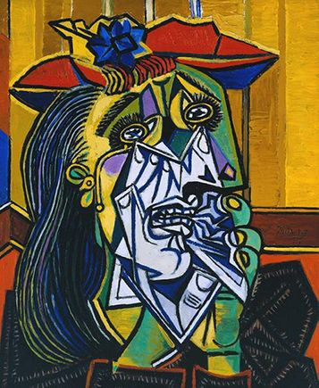
Examples of Neural Style Transfer
Picasso's Cubism Style:
Cubism is an artistic style pioneered by Pablo Picasso and Georges Braque in the early 20th century. It emphasizes the use of geometric shapes and fragmented forms to depict objects from multiple viewpoints. This example of Neural Style Transfer applies the cubist style to a portrait photograph, resulting in an abstract and fragmented image that still retains the original content of the photograph. The algorithm extracts the features of the photograph, such as the face, hair, and background, and transforms them into a cubist style that resembles the artwork of Picasso and Braque

Slide 13
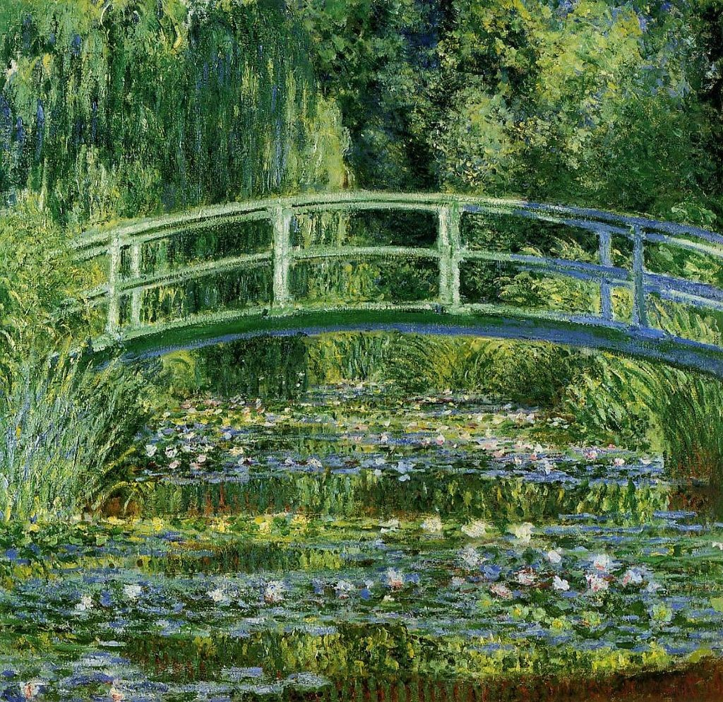
Examples of Neural Style Transfer
Anime Style:
Anime is a popular style of Japanese animation that is known for its distinct visual features, such as large eyes, colorful hair, and exaggerated expressions. This example of Neural Style Transfer applies an anime-style to a photograph of a person, resulting in a cartoon-like image that resembles an anime character. The algorithm analyzes the features of the photograph, such as the face, hair, and clothes, and transforms them into a style that resembles the artwork of popular anime series

